Slide 1


HOOKED: UNMASKING THE CRELAN BANK PHISHING ATTACK
SUBHASHIS TRIPATHY
RA2112703010020

Slide 2

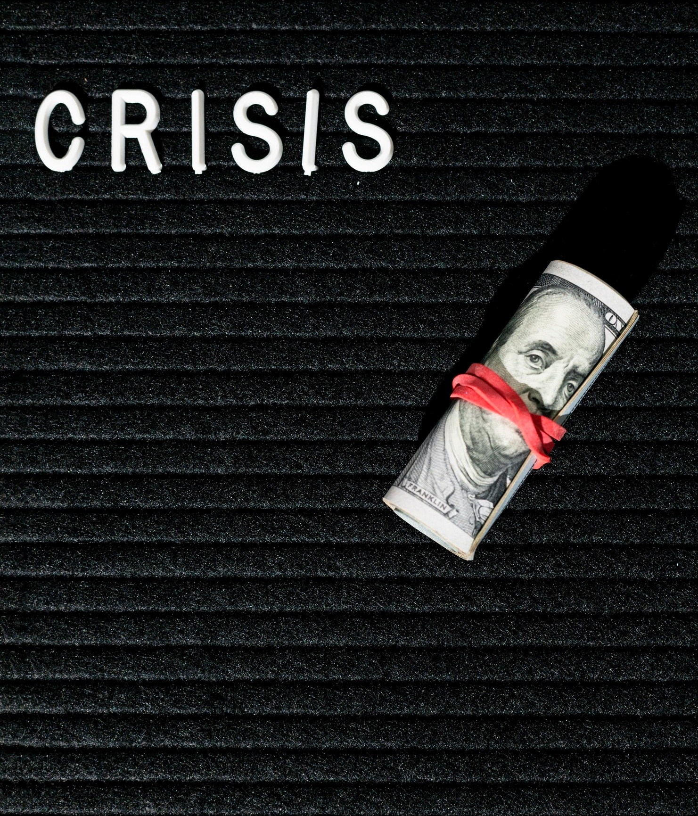
INTRODUCTION
The Crelan Bank Attack shook the ﬁnancial world, revealing vulnerabilities in modern banking systems. This presentation will delve into the intricacies of the attack and propose countermeasures to prevent future breaches.

Slide 3


CRELAN BANK ATTACK OVERVIEW
The Crelan Bank Attack involved a sophisticated cyber intrusion that compromised sensitive ﬁnancial data and led to signiﬁcant ﬁnancial losses. The attackers (two armed robbers) exploited weaknesses in the bank's security infrastructure, highlighting the need for robust defense mechanisms. It is identified by Salah Abdeslam and Sofien Ayari).

Slide 4


ATTACK METHODOLOGY
The attackers employed advanced phishing techniques and malware to gain unauthorized access to the bank's systems. Their tactics included social engineering and targeted spear phishing, enabling them to bypass traditional security measures.

Slide 5

Understand Phishing
Phishing attacks are the practice of sending fraudulent communications that appear to come from a reputable source.
It is usually done through email. The goal is to steal sensitive data like credit card and login information, or to install malware on the victim’s machine. Phishing is a common type of cyber attack that everyone should learn about in order to protect themselves.

Slide 6

VULNERABILITIES EXPLOITED
The Crelan Bank Attack exploited weaknesses in the bank's network
infrastructure and employee security awareness. These vulnerabilities allowed the attackers to inﬁltrate the system and exﬁltrate sensitive ﬁnancial data undetected.

Slide 7


DECEPTIVE EMAILS
Examining the anatomy of
fraudulent emails used in the attack. Identifying the red ﬂags and warning signs to watch out for in email communications.

Slide 8


IMPACT ON CRELAN BANK
Assessing the repercussions of the phishing attack on CRELAN Bank in the town of Anderlues(Belgium). Exploring the ﬁnancial, reputational, and regulatory implications of the security breach.
Crelan Bank lost €7.5 million. The attack damaged the bank's reputation.
The attack caused stress and anxiety for employees.

Slide 9

REGULATORY IMPLICATIONS
The Crelan Bank Attack underscores the necessity for stringent regulatory compliance and enhanced cybersecurity standards within the ﬁnancial sector. Regulatory bodies must enforce comprehensive guidelines to safeguard ﬁnancial institutions from cyber threats.

Slide 10


Response
Crelan Bank reported the attack to the authorities.
The bank took steps to improve its security, such as employee training and security awareness programs.
The bank also worked to recover the stolen funds.

Slide 11

Countermeasures and Best Practices
Implementing robust multi- factor authentication, conducting regular security training for employees, and deploying advanced intrusion detection systems are essential countermeasures to fortify against similar attacks.

Slide 12

Future Threat Landscape
As technology continues to evolve, the ﬁnancial sector faces an evolving threat landscape.
Anticipating future cyber threats and implementing proactive security measures is imperative to safeguard against potential attacks.

Slide 13




Businesses need to be aware of the risk of BEC attacks.
Lessons Learned
Employees need to be trained on how to identify and avoid phishing emails.
Businesses need to
have security in place.
strong measures

Slide 14

CONCLUSION
The Crelan Bank Attack serves as a stark reminder of the persistent cyber threats facing ﬁnancial institutions. By understanding the intricacies of the attack and implementing robust security measures, the industry can fortify against future breaches and protect sensitive ﬁnancial data.

Slide 15


Thank You
Do you have any questions?

